Slide 1
Angular JS
A brief Introduction

Slide 2
What is AngularJS
MVC Javascript Framework by Google for Rich Web Application Development

Slide 3
Features of AngularJS
Two-way Data Binding – Model as single source of truth
Directives – Extend HTML
MVC
Dependency Injection
Testing
Deep Linking (Map URL to route Definition)
Server-Side Communication

Slide 4
Data Binding
<html ng-app>
<head>
<script src='angular.js'></script>
</head>
<body>
<input ng-model='user.name'>
<div ng-show='user.name'>Hi {{user.name}}</div>
</body>
</html>

Slide 5
MVC
Model (Data)
View (UI)
Notifies
Notifies
Changes
Controller (Logic)

Slide 6
MVC
Model
JS Objects
View
DOM
Controller
JS Classes

Slide 7
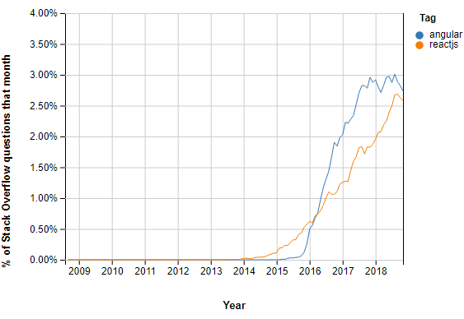

Slide 8
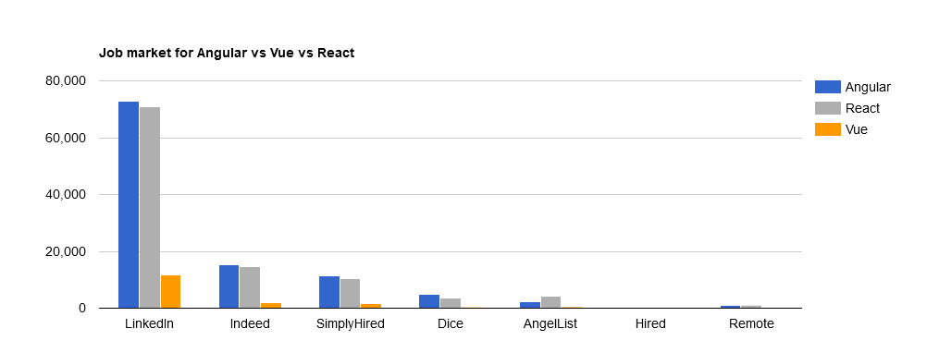

Slide 9
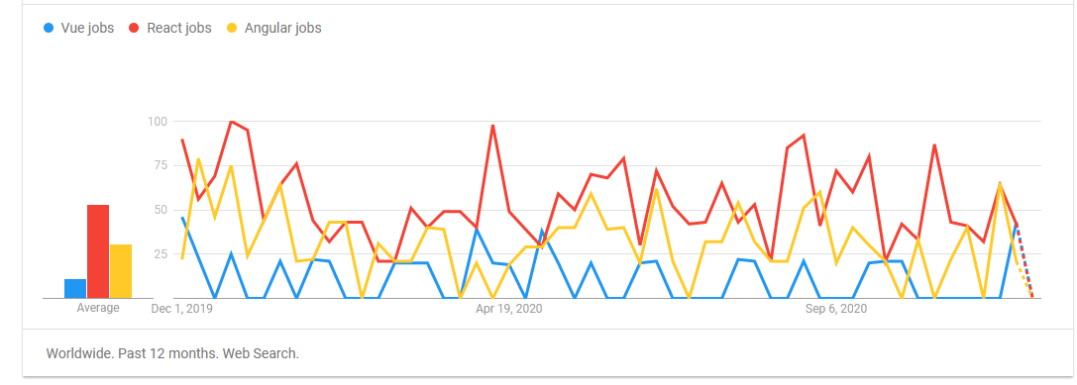

Slide 10
